Slide 1
Press the F5 key
on your keyboard
to begin this module

Slide 2

Search Initiation Overview
Notes:
Welcome! This presentation will cover how to open a new search and what changes are allowed after the ad is posted. So let’s get started!

Slide 3
How do I open a new search?
Complete the Search Initiation form found here, or call your Academic Affairs Recruitment Specialist for assistance
In addition to the Search Initiation Request form attach a draft of your advertisement, or click here for advertisement templates
Submit both documents to your Academic Affairs Recruitment Specialist

Slide 4
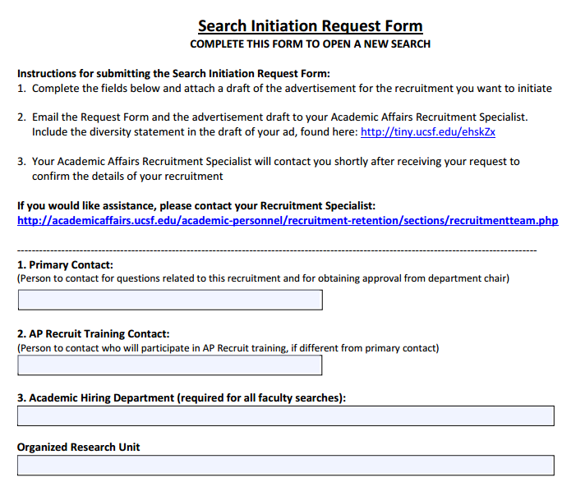

Slide 5
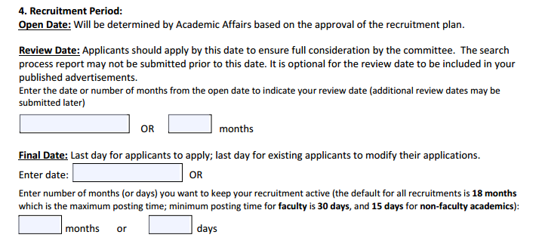

Slide 6
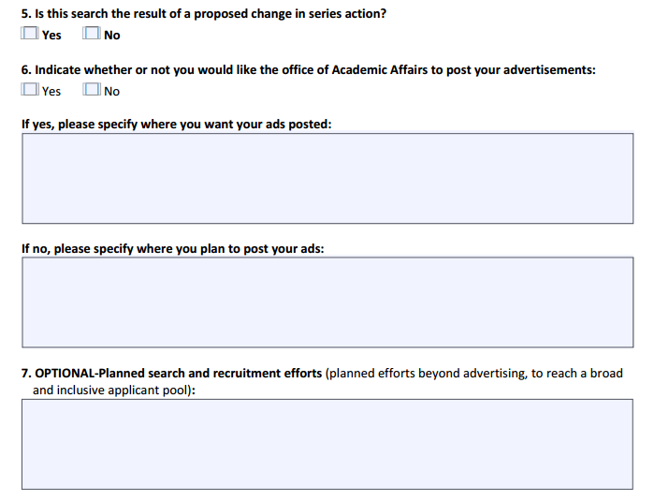
X
X

Slide 7
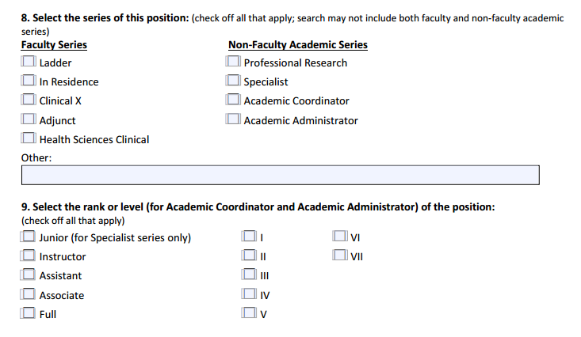
X
X

Slide 8
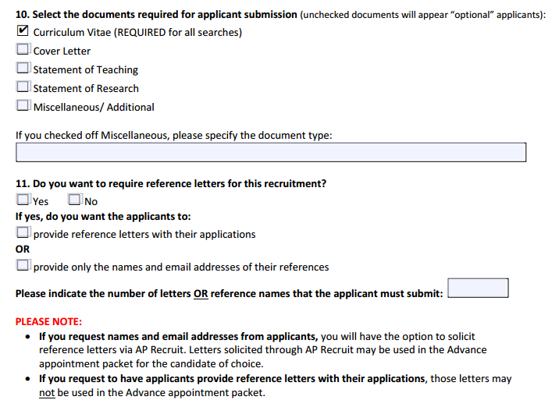
X
X

Slide 9
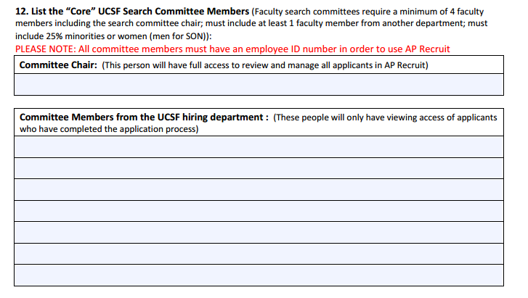
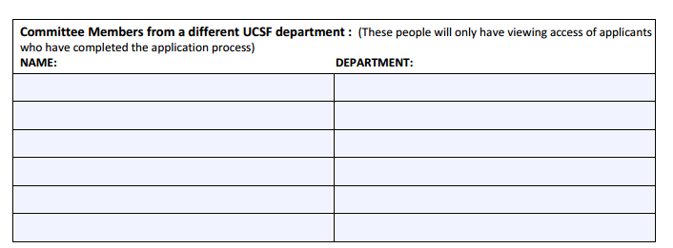

Slide 10
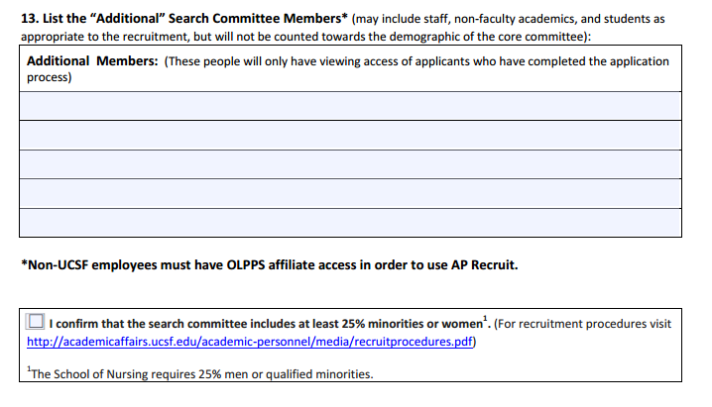
X

Slide 11
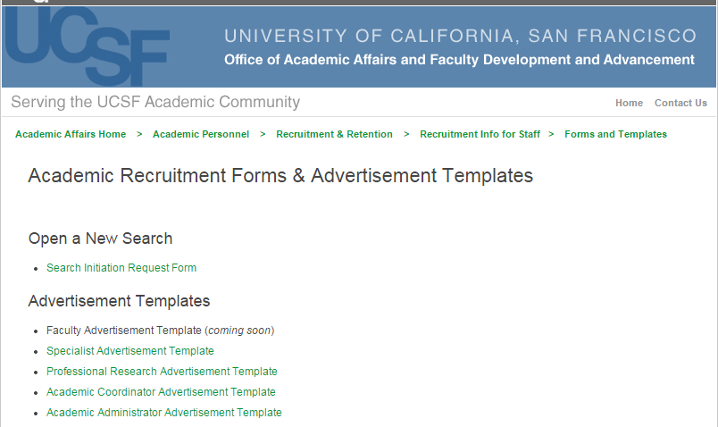
Advertisement Templates
Click here for the Advertisement Templates

Slide 12
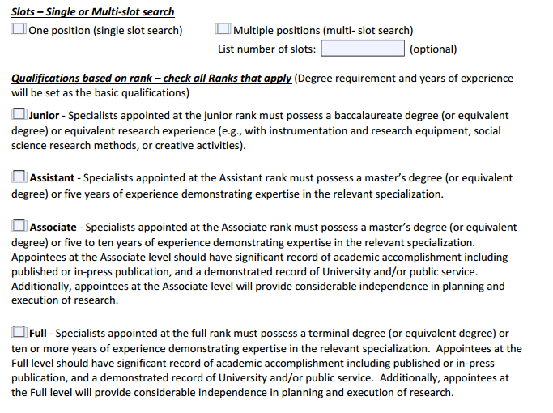
Completing the Advertisement Template

Slide 13
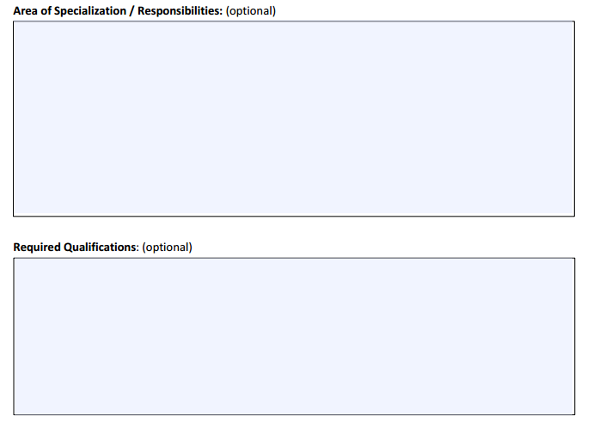
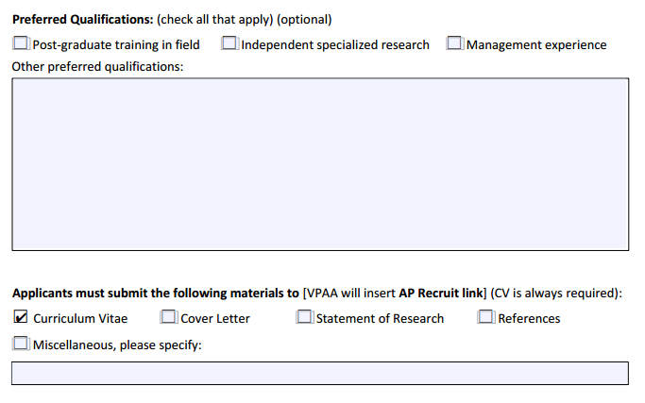
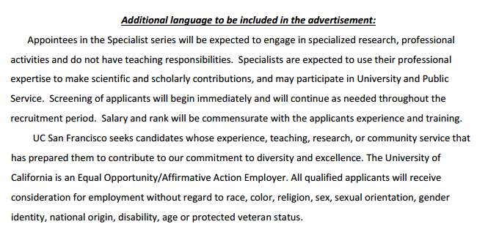
Completing the Advertisement Template

Slide 14
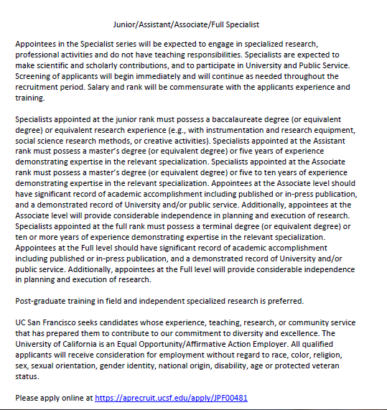

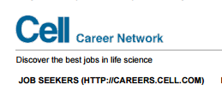


Sample Advertisement

Slide 15
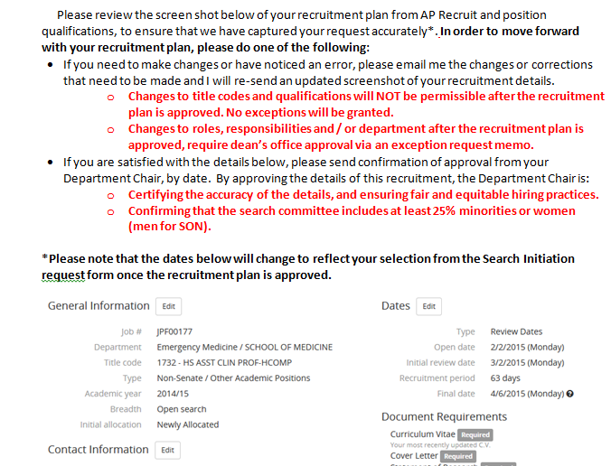

Review your Academic Recruitment Plan

Slide 16
Thank you!
For questions related to the material covered during this presentation, please contact the Academic Affairs
Recruitment Team:
Jennifer Polce Jennifer.Polce@ucsf.edu Tiffany Hom Tiffany.Hom@ucsf.edu Ronald Ong Ronald.Ong@ucsf.edu http://academicaffairs.ucsf.edu/academic-personnel/recruitment-retention/sections/recruitmentteam.php

